Slide 1
Key Stats
99.7%
SPC Machine Learning
Process Yield
ANALYSIS
21,420
Total Tests 2023
1590nm Amp Test · Yield · CONQ · Failure Prediction
1,601
Dean Foulds
Out-of-Control
Data Scientist & ML Engineer | ASN Submarine Cables
deanfoulds.xyz
143K GBP
CONQ

Slide 2
Study Overview
Can machine learning accurately predict failures from SPC analysis of 1590nm electrical amp testing?
Problem
Approach
Outcome
No real-time data feedback from splicing machines
SPC charting on full 2023 dataset
99.7% splice yield confirmed
Blind splicing drives high CONQ
Z-score outlier removal at 2.7 sigma
Amp-stage test captures 13% failures early
1,601 / 21,420 tests out-of-control (7.5%)
Lazy Regressor benchmark: 40+ models
SVR predicts amp values with low MSE
Reactive quality model
XGBoost & SVR selected as final models
CONQ reduction roadmap established
Dean Foulds | SPC Machine Learning Analysis | ASN Submarine Cables

Slide 3
Causes of Amp Splice Failures
Pulled Fibre
Foam Pressure
Mechanical stress during assembly causing fibre extraction from the splice point
External compression from protective foam causing gradual signal degradation
Tight Fibre
Too Many Fibres
Insufficient slack leading to tension-induced breaks under thermal or mechanical load
Overcrowding at the splice point causing physical interference between fibres
Poor Routing
Manufacturing Deviations
Incorrect cable path creating excessive bend radius and stress concentration points
Process deviations during production — root cause of C1 failures (26.7% of all failures)
Dean Foulds | SPC Machine Learning Analysis | ASN Submarine Cables

Slide 4
Yield Calculation & Cost of Non-Quality
Process Yield
Cost of Non-Quality (CONQ)
99.7%
143,135
(94,432 - 318) / 94,432 x 100 = 99.7%
GBP
N x (T x P x C_labour + C_material + C_overhead)
(Splices - Failures) / Splices x 100
N=318
Rework
T=3h
Per rework
2,951
32
318
P=3
Persons
50 GBP/h
Labour
Amps Produced
Splices/Unit
Failures
20 GBP
Material
15 GBP
Overhead
C1 failures = 85 / 318 = 26.7% of all splice failures
318 x (3 x 3 x 50 + 20 + 15) = 318 x 450 = 143,100 GBP
Dean Foulds | SPC Machine Learning Analysis | ASN Submarine Cables

Slide 5
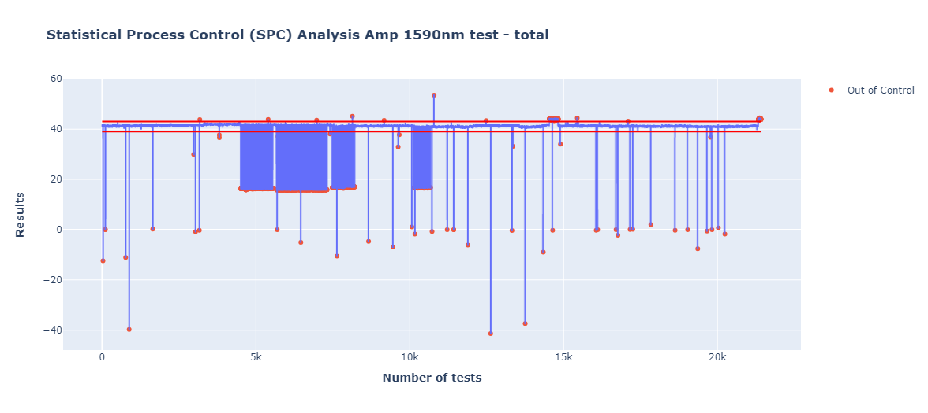
SPC Results — All Amp Tests (1590nm)
SPC chart for all 2023 1590nm amp tests. Out-of-control points highlighted. UCL=43, LCL=39. Total: 21,420 tests, 1,601 out-of-control (7.5%).
Dean Foulds | SPC Machine Learning Analysis | ASN Submarine Cables

Slide 6
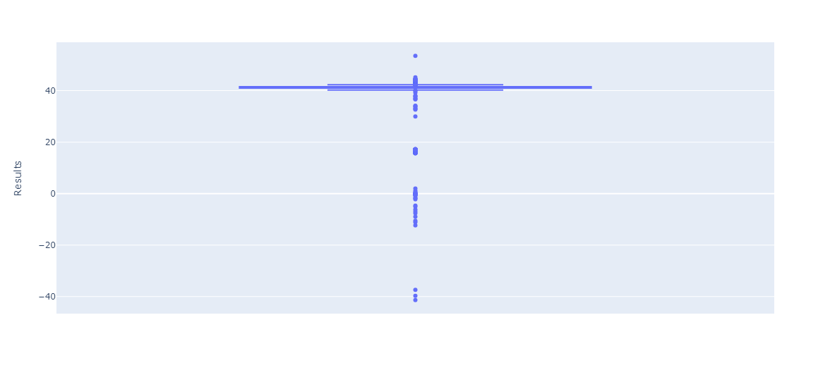
Visualising Out-of-Control Points
Scatter overlay showing out-of-control points against the SPC line chart. Serial numbers of failed units identified for traceability.
Dean Foulds | SPC Machine Learning Analysis | ASN Submarine Cables

Slide 7
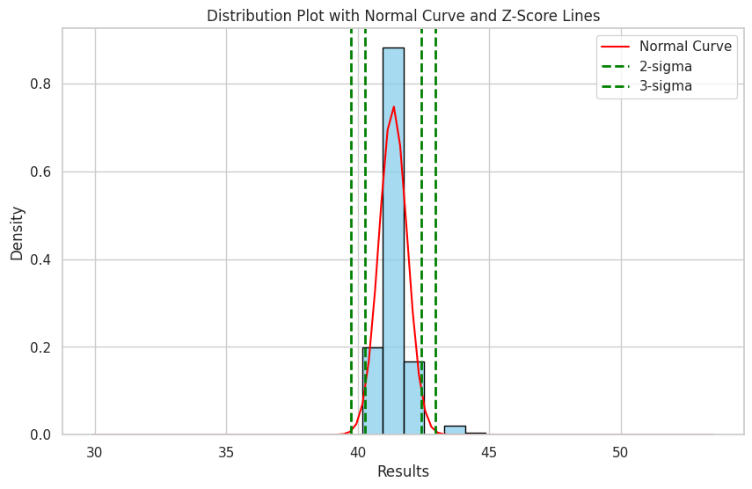
Distribution Analysis — Results
Histogram with normal distribution curve fitted. Z-score lines at 2 and 3 sigma shown in green. Data exhibits near-normal distribution post-cleaning.
Dean Foulds | SPC Machine Learning Analysis | ASN Submarine Cables

Slide 8
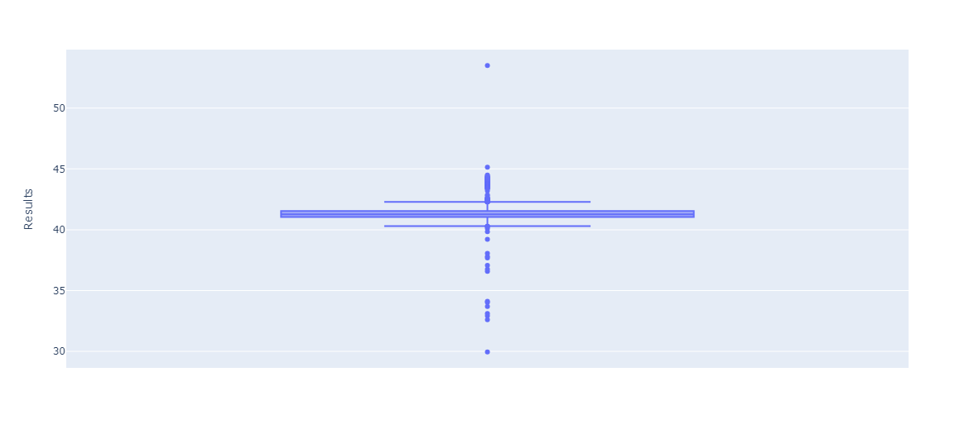
Outliers Removed — Box Plot
Box plot after Z-score outlier removal at threshold 2.7 sigma. Distribution tightened significantly, reducing noise for ML model training.
Dean Foulds | SPC Machine Learning Analysis | ASN Submarine Cables

Slide 9
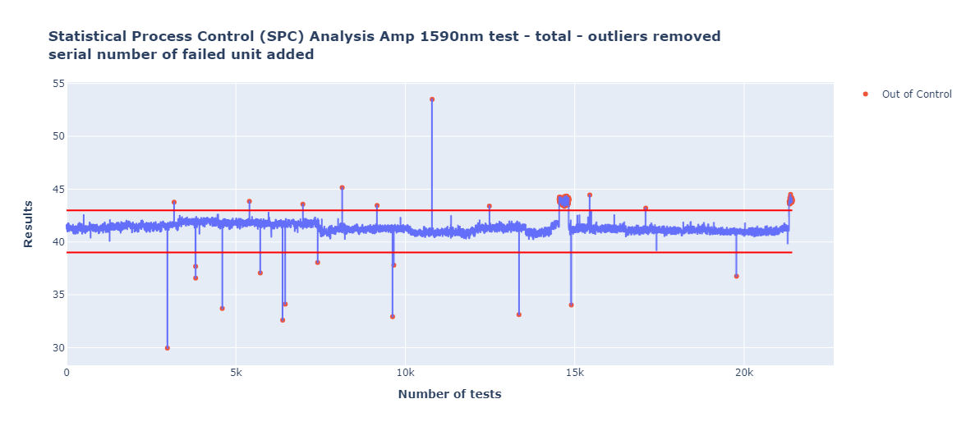
SPC Analysis — Majority Outliers Removed
SPC chart after outlier removal. Remaining out-of-control points represent true systematic failures. Much cleaner signal for predictive modelling.
Dean Foulds | SPC Machine Learning Analysis | ASN Submarine Cables

Slide 10
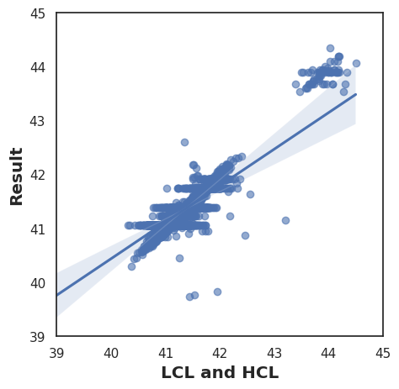
Logistic Regression Analysis — Pass/Fail vs Results
Scatter plot of Results vs Test Status (0=FAIL, 1=PASS) with OLS trendline. Shows correlation between measurement values and pass/fail outcomes.
Dean Foulds | SPC Machine Learning Analysis | ASN Submarine Cables

Slide 11
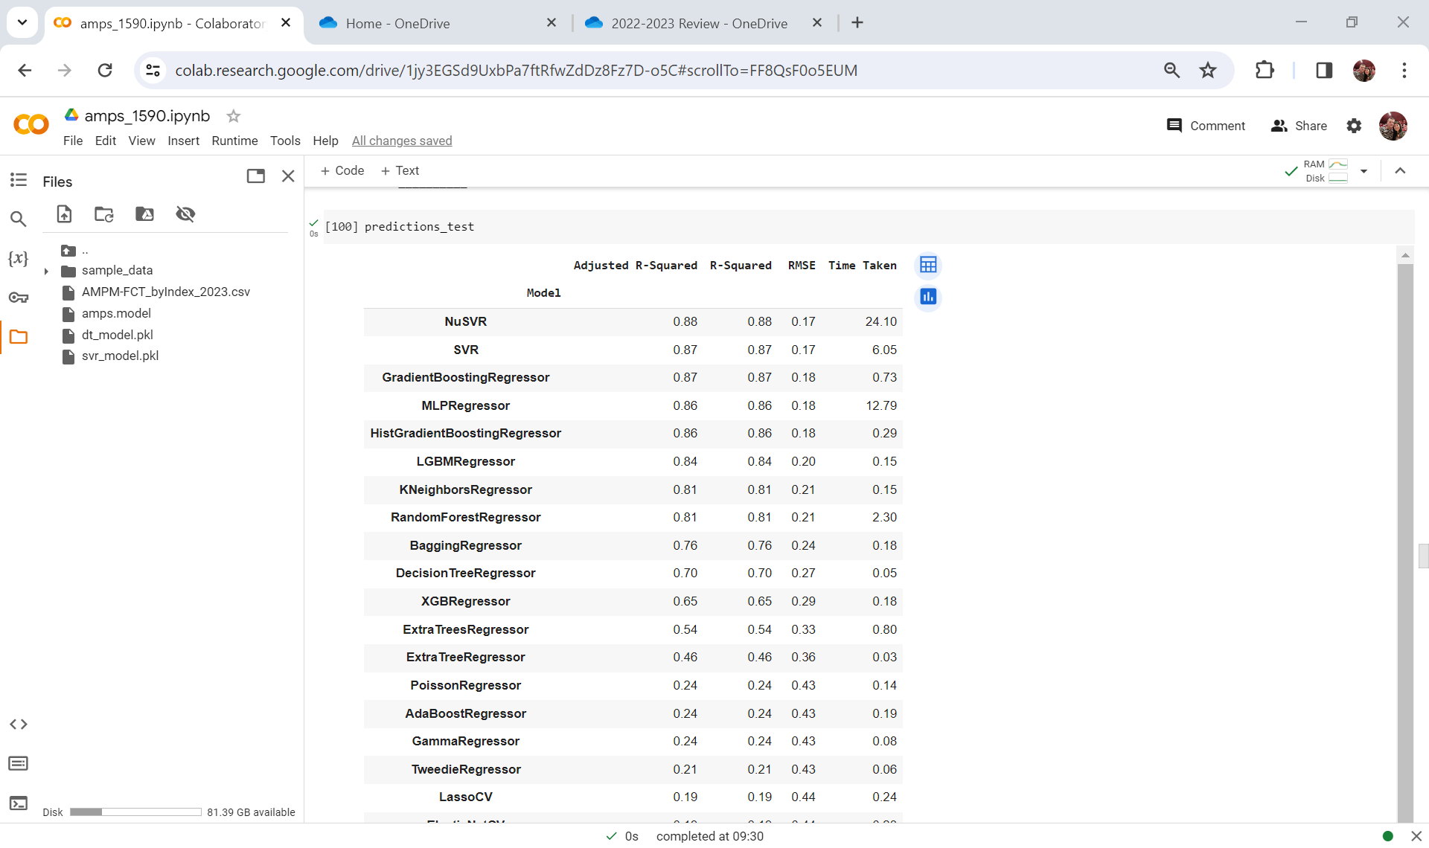
Pass/Fail Criteria — Label Encoding
Test Status encoded as binary labels: FAIL=0, PASS=1. Used as feature alongside Limit High Flt and Limit Low Flt for model training.
Dean Foulds | SPC Machine Learning Analysis | ASN Submarine Cables

Slide 12
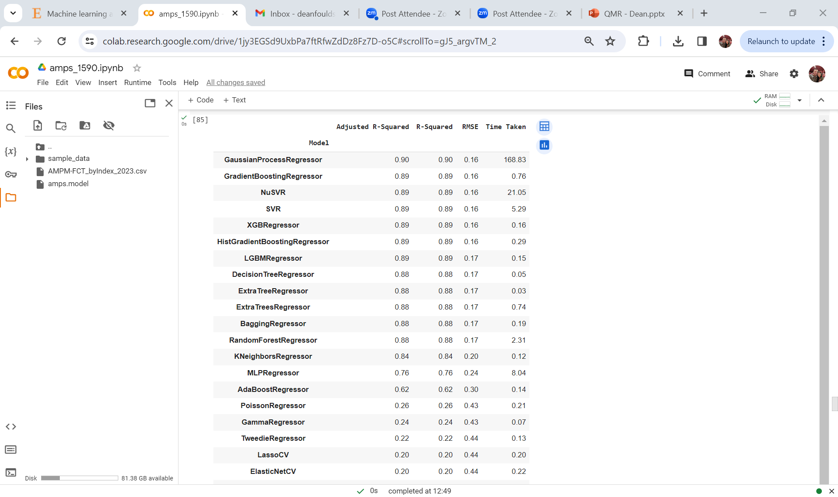
Initial Lazy Regressor Results — Model Benchmarking
Automated benchmarking of 40+ sklearn models. Ranked by R-squared, RMSE and adjusted R-squared. XGBoost and SVR identified as top performers.
Dean Foulds | SPC Machine Learning Analysis | ASN Submarine Cables

Slide 13
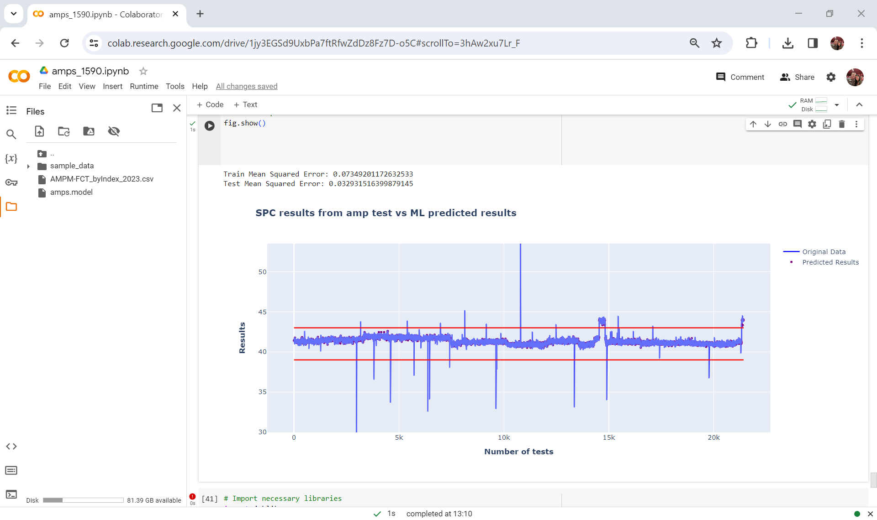
XGBoost Predictions vs Actual SPC Results
XGBoost (n_estimators=400, lr=0.08, max_depth=3) predictions (purple dots) overlaid on actual results (blue line). Control limits shown in red.
Dean Foulds | SPC Machine Learning Analysis | ASN Submarine Cables

Slide 14
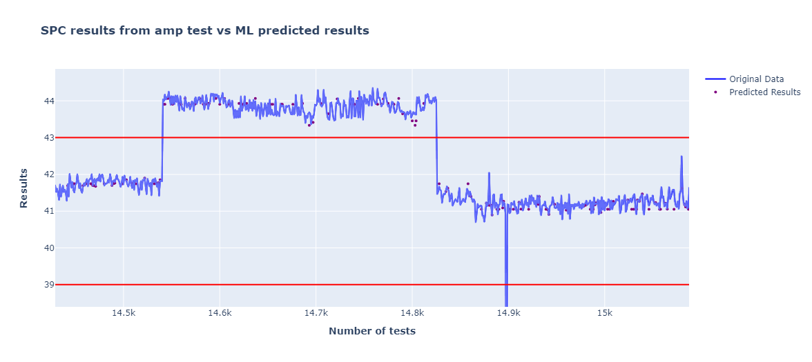
XGBoost Predictions — Zoomed View
Zoomed view of XGBoost predictions vs actual values. Model tracks the SPC curve closely within control limits, demonstrating strong predictive accuracy.
Dean Foulds | SPC Machine Learning Analysis | ASN Submarine Cables

Slide 15
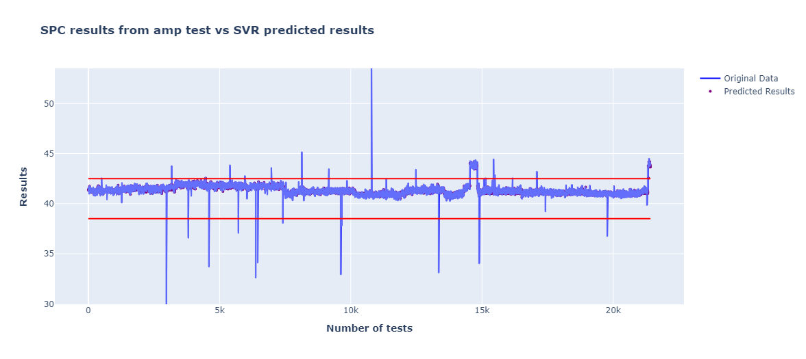
SVR (RBF Kernel) Predictions vs Actual
Support Vector Regression predictions overlaid on actual SPC results. SVR achieved lowest test MSE of 0.0048 — selected as production model.
Dean Foulds | SPC Machine Learning Analysis | ASN Submarine Cables

Slide 16
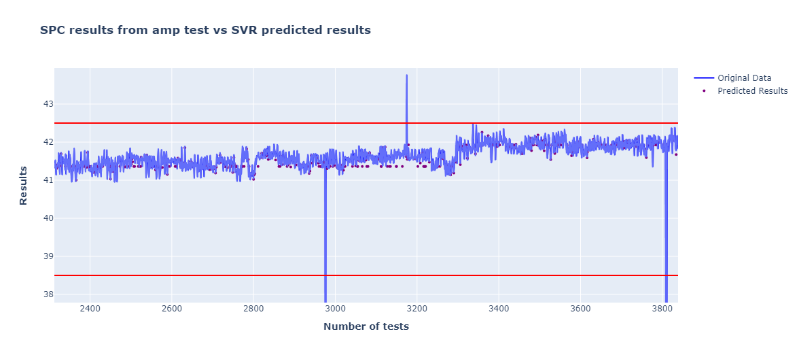
SVR Predictions — Zoomed View
Zoomed SVR prediction view. Tight clustering of predictions around actual values confirms model accuracy within the UCL/LCL control window.
Dean Foulds | SPC Machine Learning Analysis | ASN Submarine Cables

Slide 17
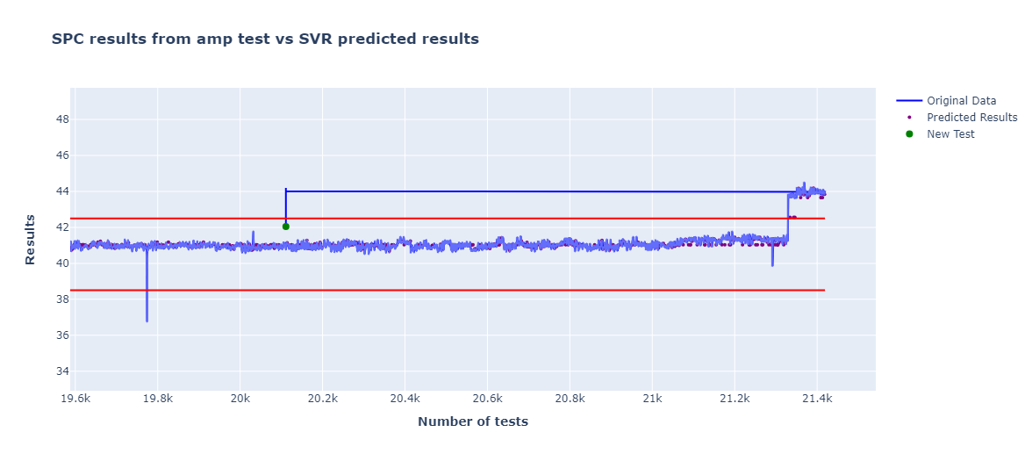
First Prediction — Known Input Validation
Validation: Input [41.523, 41.723, 0] -> SVR Predicted: 42.044. Green dot shows new test point plotted against historical SPC data. Within UCL.
Dean Foulds | SPC Machine Learning Analysis | ASN Submarine Cables

Slide 18
Machine Learning Models — Evaluation & Selection
Decision Tree
Baseline
Lazy Regressor
Screening
Initial baseline. Fast, interpretable. Established benchmark R-squared score for comparison.
Benchmarked 40+ sklearn models automatically. Identified XGBoost & SVR as top performers without manual tuning.
- 80/20 split, random_state=42
- 40+ models ranked by R-sq & RMSE
- Target: Results (continuous)
- No hyperparameter tuning required
- Benchmark for all other models
- Fast automated candidate selection
XGBoost
Primary Model
SVR (RBF Kernel)
Production
n_estimators=400, max_depth=3, lr=0.08. Gradient boosted trees trained on UCL/LCL boundary labels.
Best test MSE=0.0048. Non-linear RBF kernel. Final deployed model for real-time prediction.
- subsample=0.8, colsample_bytree=0.8
- kernel='rbf' (non-linear)
- eval_metric: RMSE
- Input [41.523,41.723,0] -> 42.044
- Saved: amps.model
- Saved: svr_model.pkl
Features: Limit High Flt, Limit Low Flt, Test Status | Target: Results | SVR selected as production model
Dean Foulds | SPC Machine Learning Analysis | ASN Submarine Cables

Slide 19
Conclusions & Recommendations
99.7% Yield
SVR Best Model
Highly efficient splice process across 94,432 total splices. C1 failures at 26.7% require targeted root cause analysis.
SVR with RBF kernel achieved lowest test MSE of 0.0048. Successfully predicts amp measurements from control inputs.
CONQ = 143K GBP
Data Feedback Gap
Cost of non-quality driven by blind splicing. Real-time data feedback would eliminate the majority of rework costs.
Lack of real-time data from splicing machines directly proportional to CONQ increase — highest priority recommendation.
7.5% Out-of-Control
Next Steps
1,601 from 21,420 2023 tests outside UCL/LCL. Amp-stage test captures 13% early, enabling proactive intervention.
Deploy SVR with live SPC monitoring. Investigate C1 root cause. Automate alerts when predictions approach UCL/LCL.
Dean Foulds | SPC Machine Learning Analysis | ASN Submarine Cables

Slide 20
Thank You
Dean Foulds
Data Scientist & ML Engineer
deanfoulds.xyz | github.com/Dean-Foulds | LinkedIn: dean-foulds
94,432
99.7%
4 Models
143K GBP
Splices Analysed
Process Yield
Evaluated
CONQ Identified

